Slide 1
Number plate Detection
-Group 14
G. RVNS ASHISH
R VENKATESH PRASAD
M.NAGA KAVYA
C.GAYATHRI REDDY
-CB.EN.U4CSE19020
-CB.EN.U4CSE19047
-CB.EN.U4CSE19133
-CB.EN.U4CSE19608

Slide 2
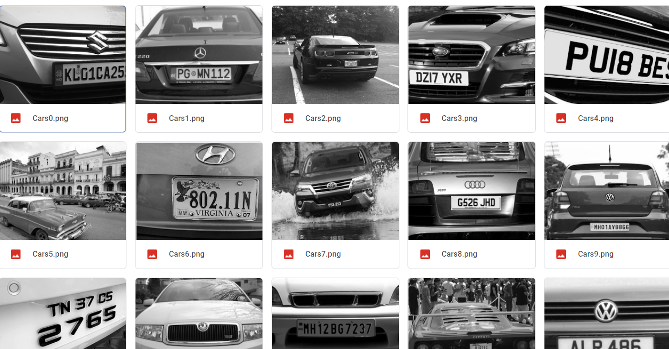
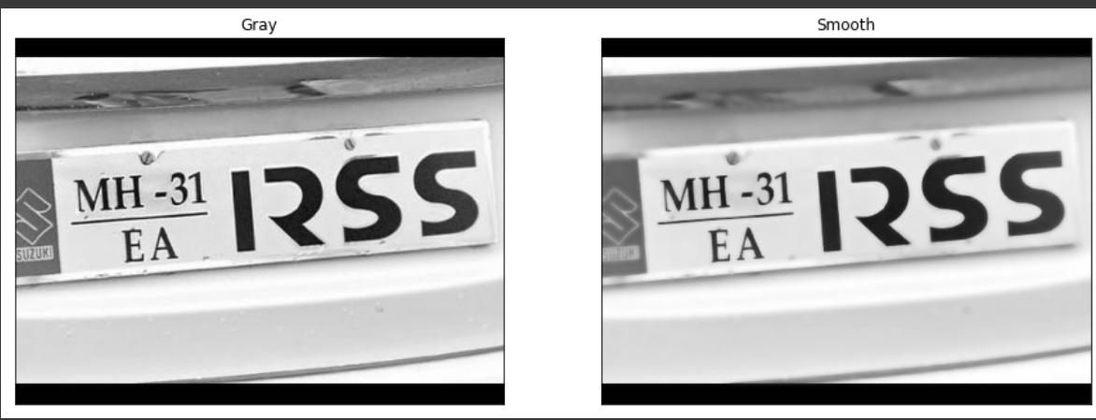
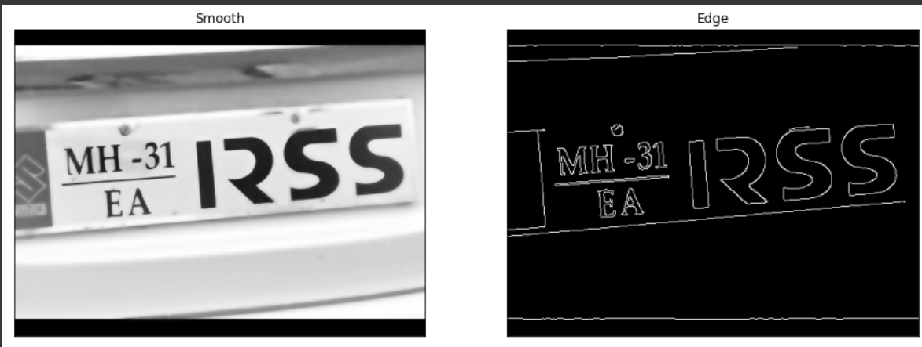
GRAY SCALE Images
By importing cv2 the original images are converted into gray scale images which are stored in test folder as follows.
Later the images went through smoothing,and edge detection

Slide 3
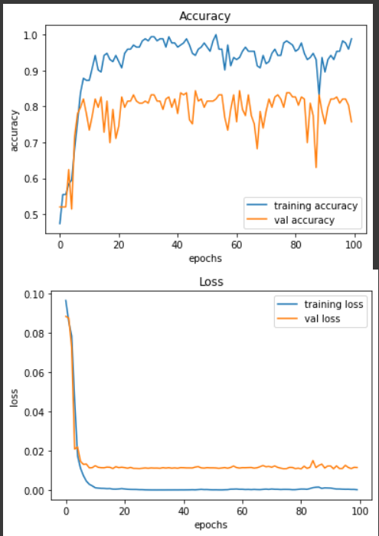
Analysis
The graph between the epochs with respect to accuracy and loss is shown below.

Slide 4
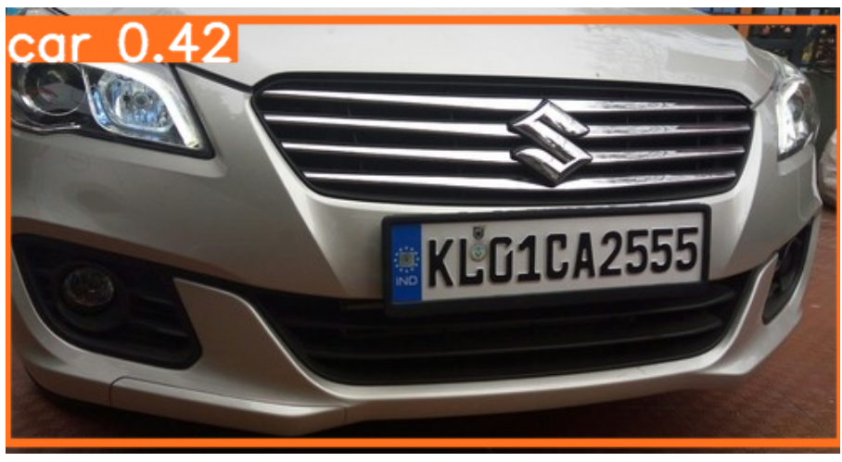
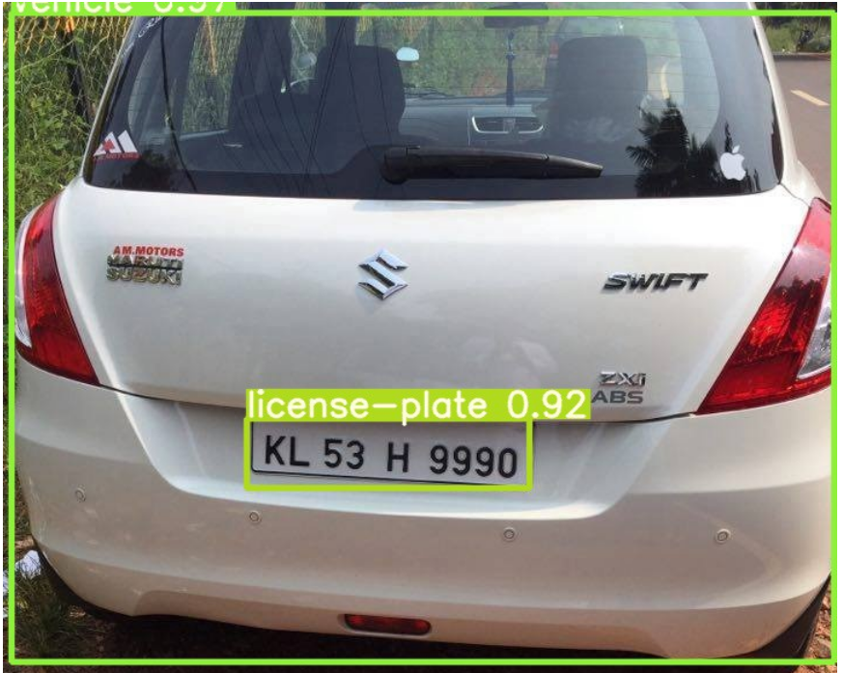
USING YOLOV5
For detecting the car along with license plate YOLOV5 makes things easier. So, we‘ve used YOLOV5 for detecting the car and license plate.

Slide 5
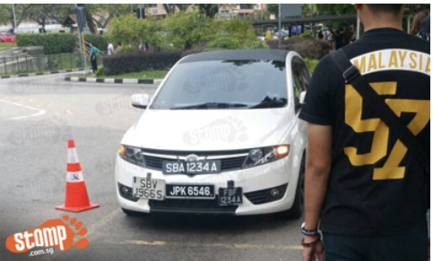
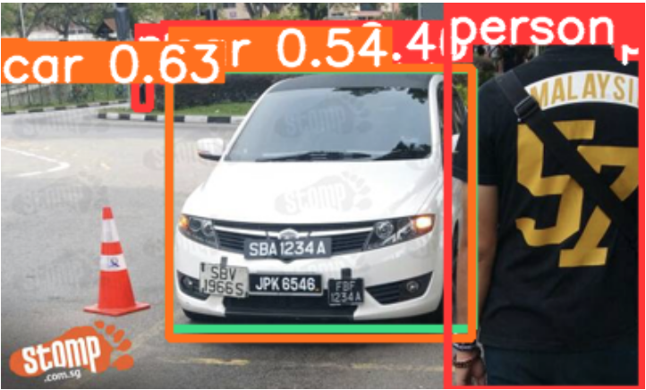
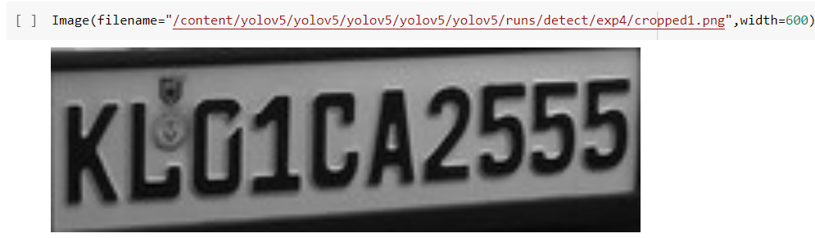
BEFORE
AFTER

Slide 6
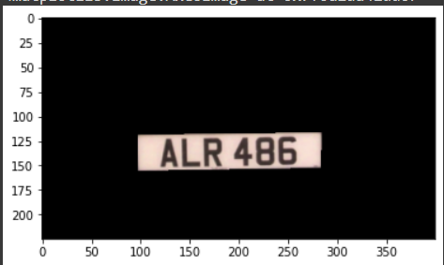
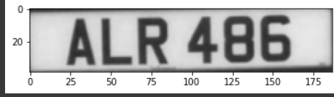
NUMBER PLATE EXTRACTION
Through importing cv2 we’ve done the required features such as noise reduction and edge reduction we’ve drawn a required contours to extract the text from the image.

Slide 7
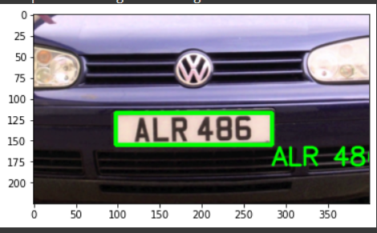
Using OCR(Optical Character Recognition)
Extracting and printing the text from the image using OCR.

Slide 8
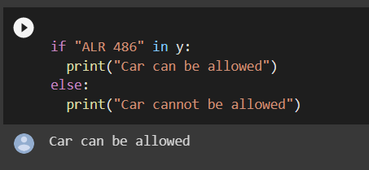
OUTPUT
If the actual and predicted output matches then the car can be allowed.

